Slide 1
AI 프로그래밍 - 13주차
성명

Slide 2
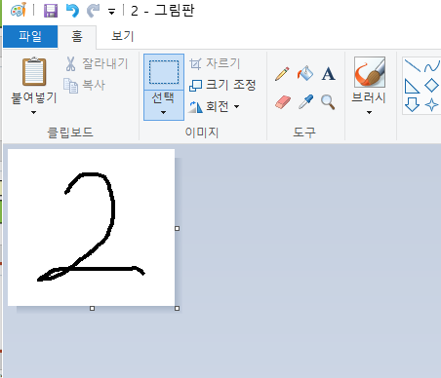

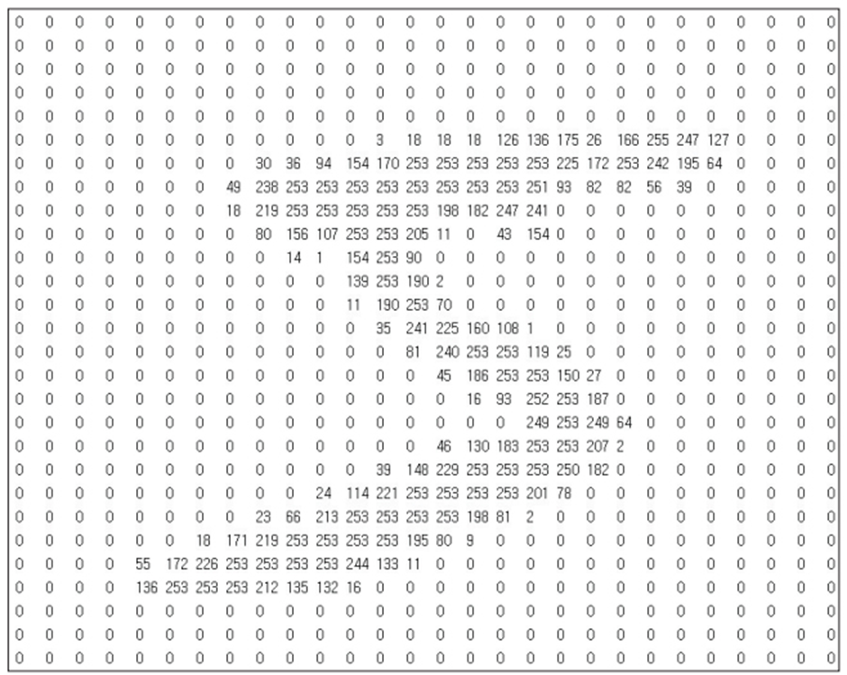
MNIST 필기체 숫자 인식
인하공전 컴퓨터 정보과

Slide 3
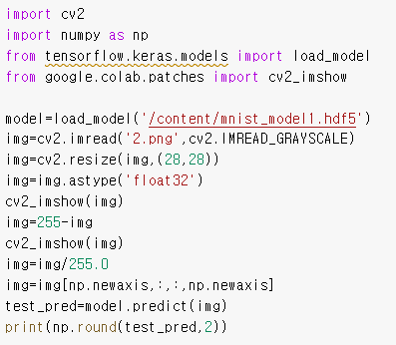
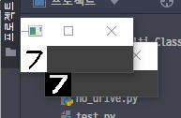

MNIST 필기체 숫자 인식
(과제1)
인하공전 컴퓨터 정보과
자료실 model mnist_model1.hdf5 사용
직접 그림판으로 그린 image를 이용하여
Test하고 그림 이미지와 분류 결과를 제출
image
분류 결과

Slide 4
Convolution Neural Network (CNN)
(과제2)
인하공전 컴퓨터 정보과
모델 디자인 (mnist_paratest.ipynb)
예제 code를 이용하여 model.summar가 다음과 같이 출력되도록 code를 수정하고 제출
code
Model: "sequential"
_________________________________________________________________
Layer (type) Output Shape Param #
=================================================================
conv2d (Conv2D) (None, 26, 26, 16) 160
_________________________________________________________________
max_pooling2d (MaxPooling2D) (None, 13, 13, 16) 0
_________________________________________________________________
conv2d_1 (Conv2D) (None, 13, 13, 32) 4640
_________________________________________________________________
max_pooling2d_1 (MaxPooling2 (None, 6, 6, 32) 0
_________________________________________________________________
conv2d_2 (Conv2D) (None, 4, 4, 64) 18496
_________________________________________________________________
flatten (Flatten) (None, 1024) 0
_________________________________________________________________
dense (Dense) (None, 64) 65600
_________________________________________________________________
dense_1 (Dense) (None, 10) 650
=================================================================
Total params: 89,546
Trainable params: 89,546
Non-trainable params: 0
_________________________________________________________________
model = models.Sequential() input_shape = (28, 28, 1) model.add(layers.Input(shape=input_shape)) model.add(layers.Conv2D(16, (3, 3), activation='relu')) model.add(layers.MaxPooling2D((2, 2))) model.add(layers.Conv2D(32, (3, 3), activation='relu', padding='same')) model.add(layers.MaxPooling2D((2, 2))) model.add(layers.Conv2D(64, (3, 3), activation='relu')) model.add(layers.Flatten()) model.add(layers.Dense(64, activation='relu')) model.add(layers.Dense(10, activation='softmax'))

Slide 5
Convolution Neural Network (CNN)
(과제3)
인하공전 컴퓨터 정보과
모델 디자인 (mnist_paratest.ipynb)
예제 code를 이용하여 model.summar가 다음과 같이 출력되도록 code를 수정하고 제출
code
Model: "sequential"
_________________________________________________________________
Layer (type) Output Shape Param #
=================================================================
conv2d (Conv2D) (None, 28, 28, 32) 320
_________________________________________________________________
max_pooling2d (MaxPooling2D) (None, 14, 14, 32) 0
_________________________________________________________________
conv2d_1 (Conv2D) (None, 10, 10, 64) 51264
_________________________________________________________________
max_pooling2d_1 (MaxPooling2 (None, 5, 5, 64) 0
_________________________________________________________________
conv2d_2 (Conv2D) (None, 3, 3, 128) 73856
_________________________________________________________________
flatten (Flatten) (None, 1152) 0
_________________________________________________________________
dense (Dense) (None, 64) 73792
_________________________________________________________________
dense_1 (Dense) (None, 10) 650
=================================================================
Total params: 199,882
Trainable params: 199,882
Non-trainable params: 0
_________________________________________________________________
input_shape = (28, 28, 1) model.add(layers.Input(shape=input_shape)) model.add(layers.Conv2D(32, (3, 3), activation='relu', padding='same')) model.add(layers.MaxPooling2D((2, 2))) model.add(layers.Conv2D(64, (5, 5), activation='relu')) model.add(layers.MaxPooling2D((2, 2))) model.add(layers.Conv2D(128, (3, 3), activation='relu')) model.add(layers.Flatten()) model.add(layers.Dense(64, activation='relu')) model.add(layers.Dense(10, activation='softmax'))

